Slide 1
Football kit
Salters’ School have a new football kit.
Blue shirt and white shorts.
Salters’
UYSEG

Slide 2
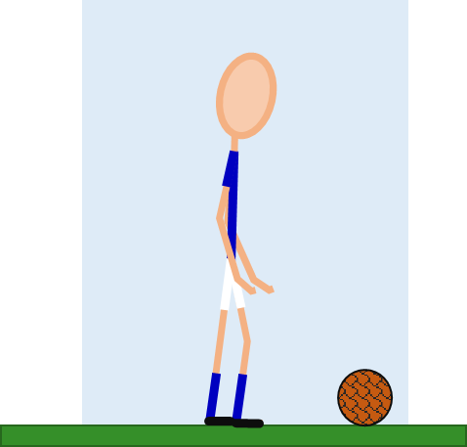
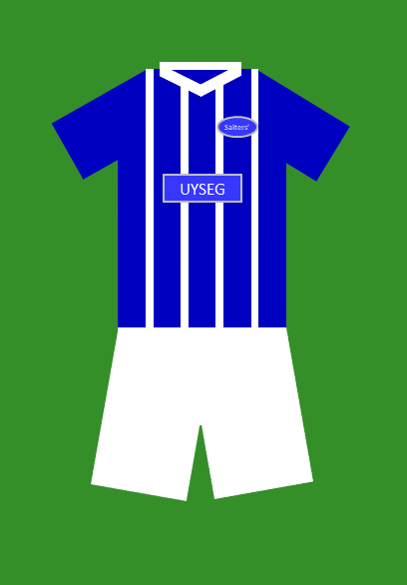
Football kit
Why do you think the football kit looks blue and white?
Blue light reflects off the blue shirt
The shirt makes the light turn blue
Blue light reflects off the white shorts

